Slide 1

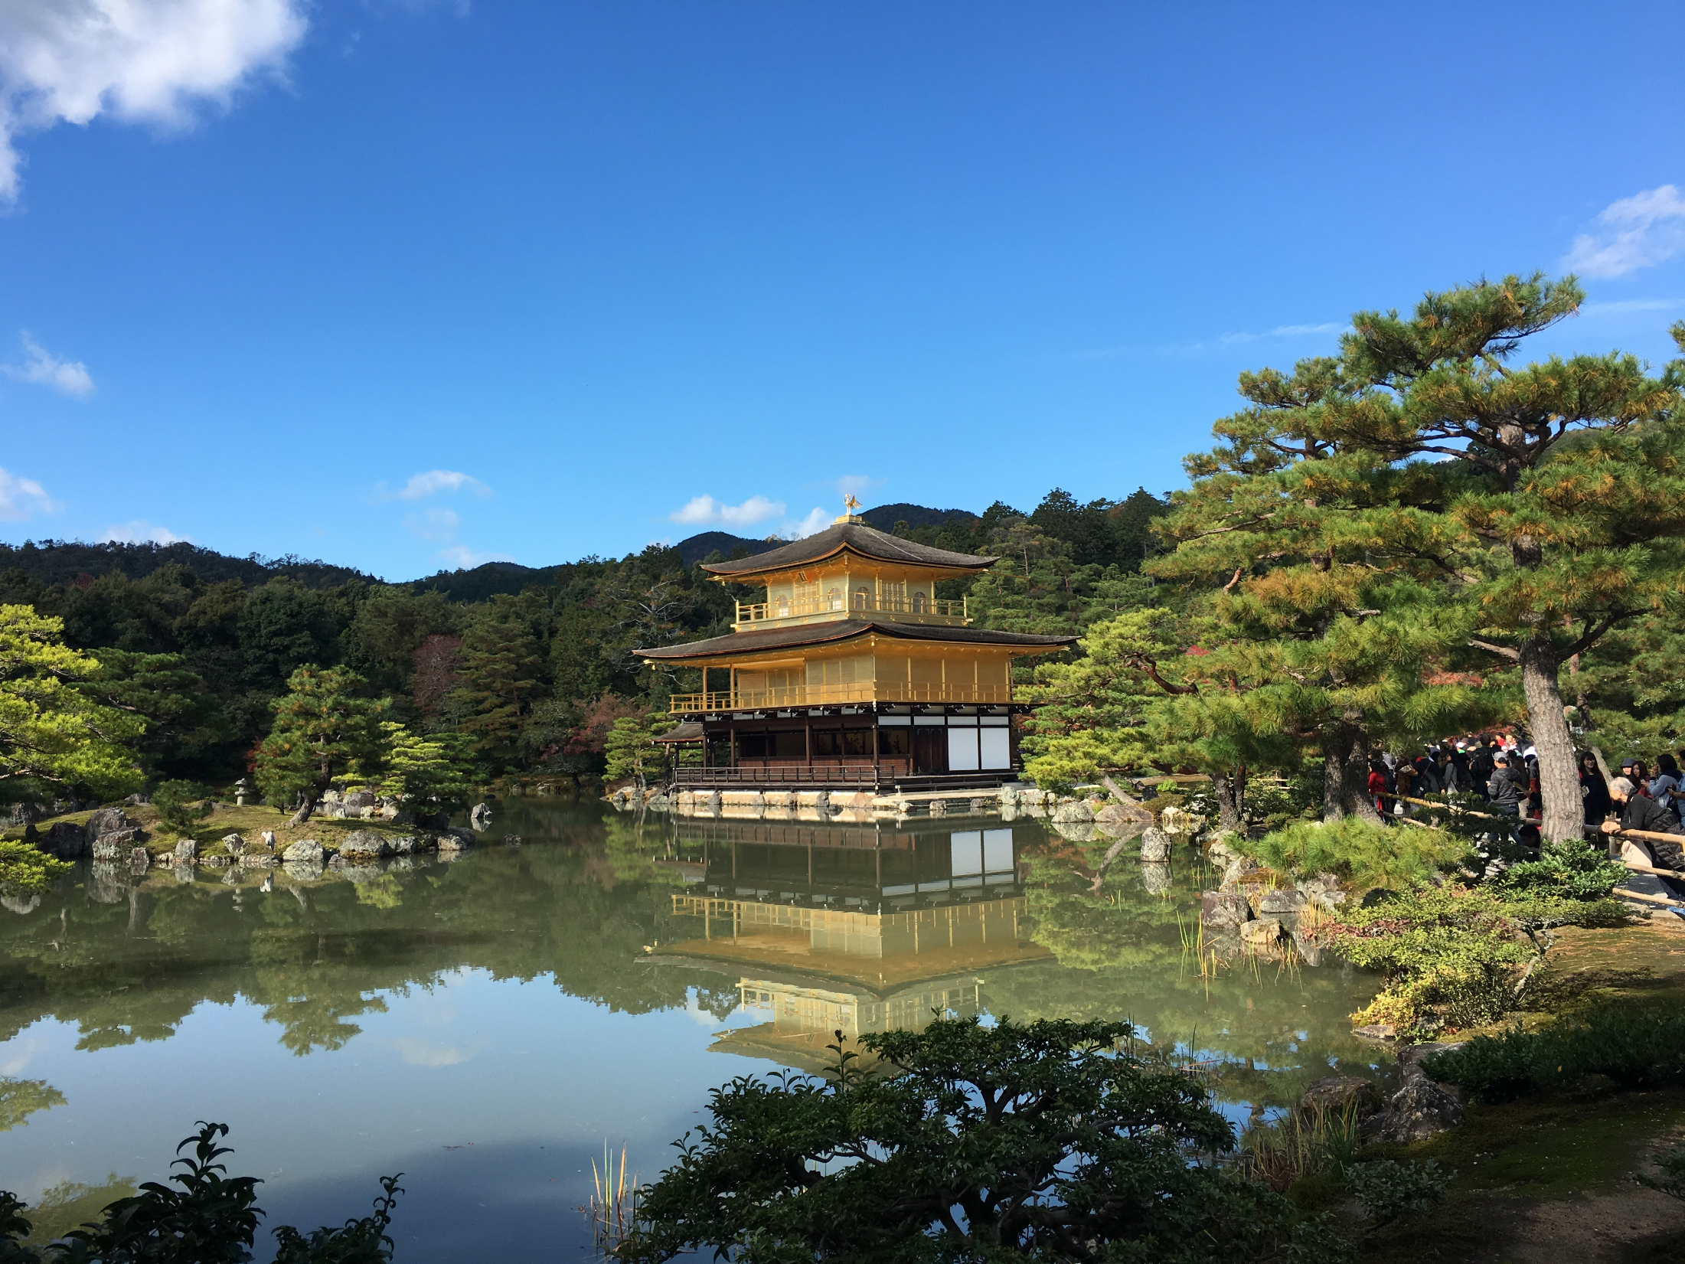
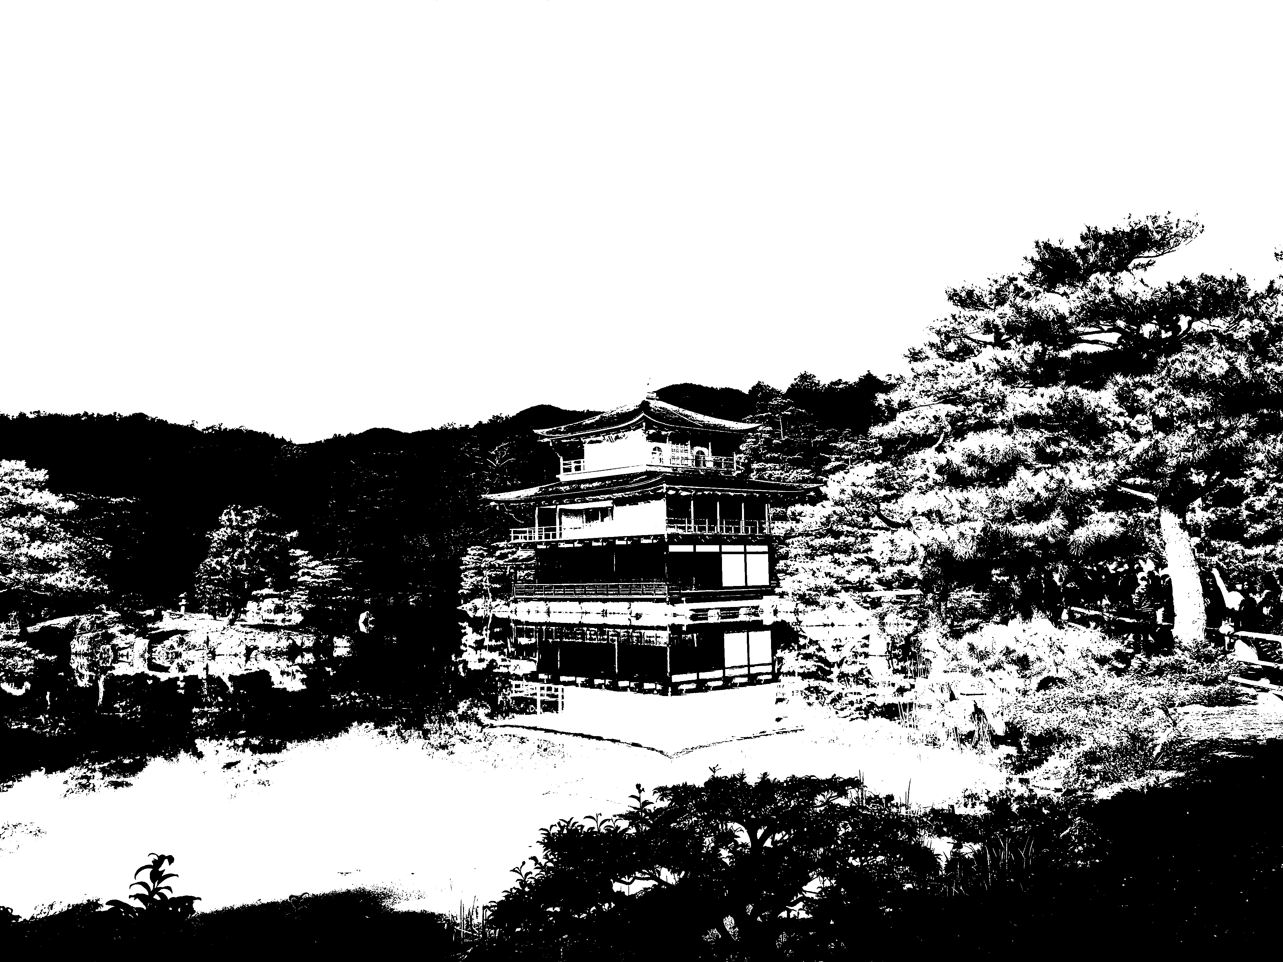
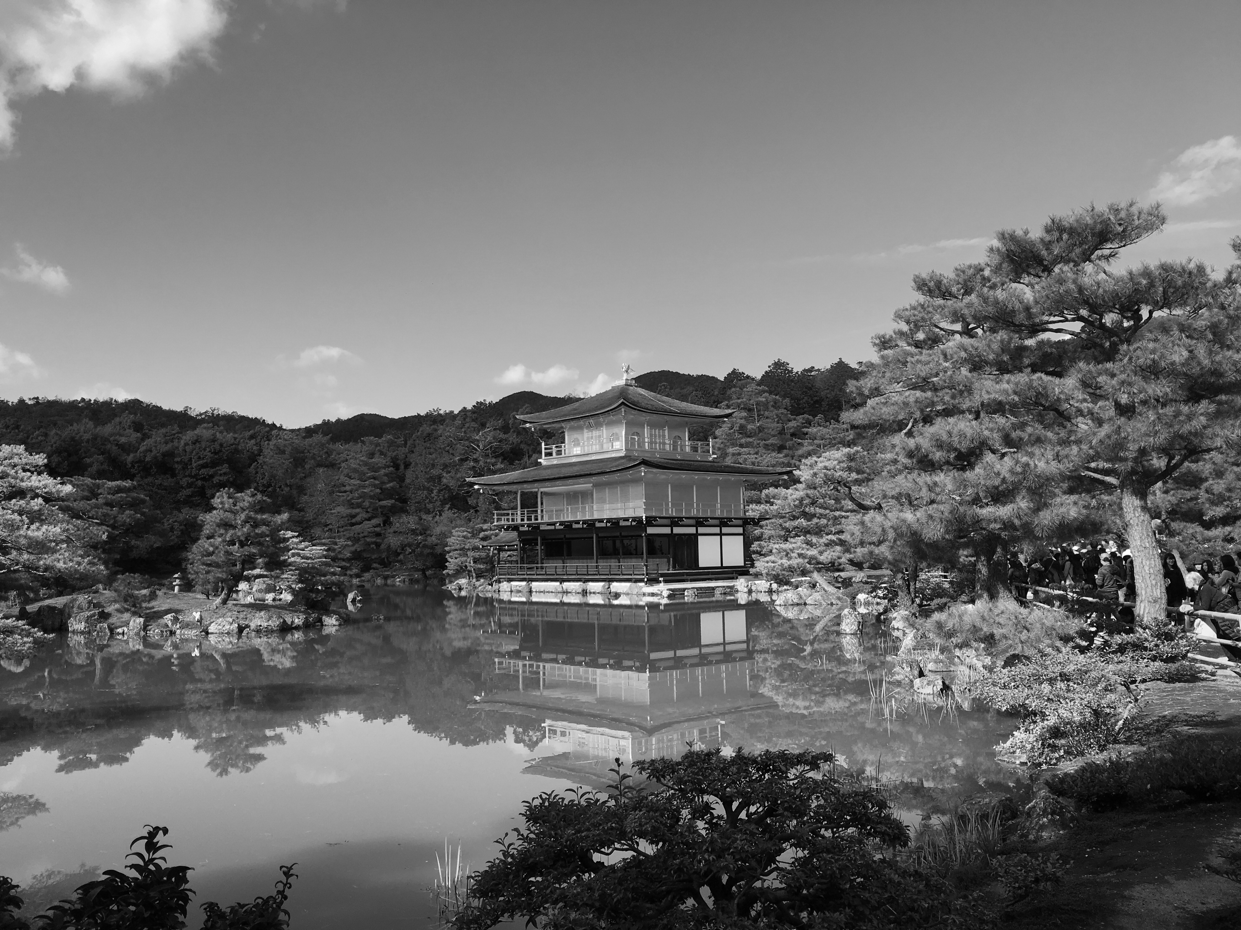
OneClickPhotoshop
Presenter : Tim Hsing

Slide 2
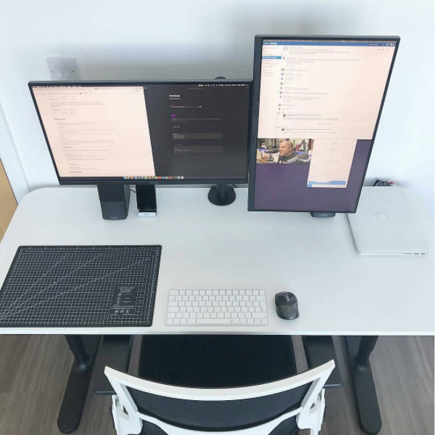
Outline
Introduction
Filter : AForge.NET
Code Demo
WindowGram
OneClickPhotoshop
Demo

Slide 3
Introduction
Idea Concept
Import Image
Select Filter
Preview and Save Image
FilterBox Apply Filter
OpenFileDialog
ComboBox
AForge.NET
SaveFileDialog
PictureBox
Buttom
PictureBox
OtsuThreshold
Switch Case
Grayscale
SaturationCorrection

Slide 4




Filter : AForge.NET
AForge.NET
AForge.Imaging
Linear color correction filters
Saturation correction
Image re-coloring filters
Grayscale
Adaptive binarization
Otsu thresholding
Notes:
线性色彩校正滤镜
图像重新着色过滤器
自适应二值化

Slide 5
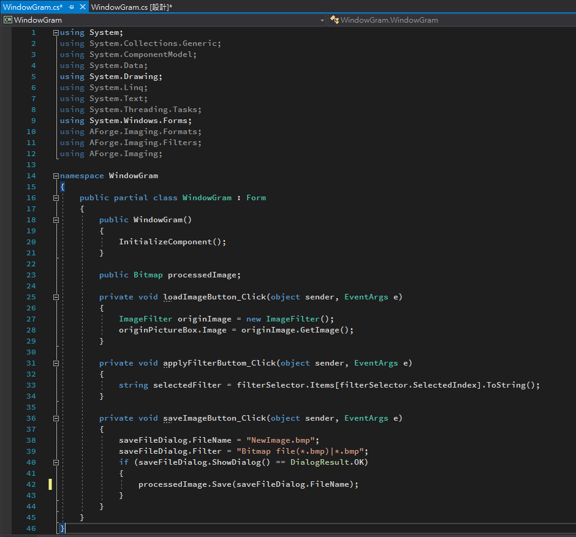
Code Demo
Main Form

Slide 6
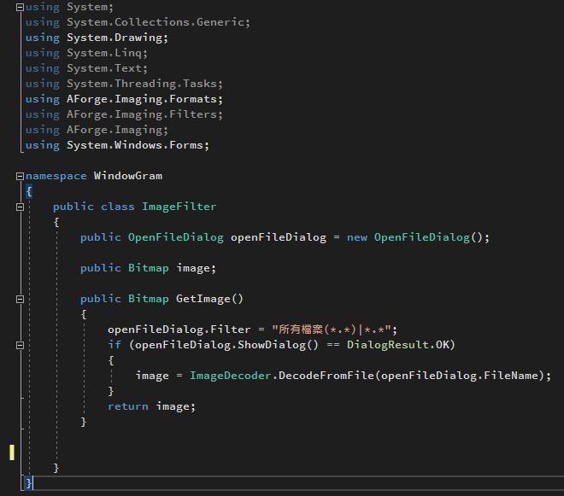
Code Demo
Class ImageFilter

Slide 7
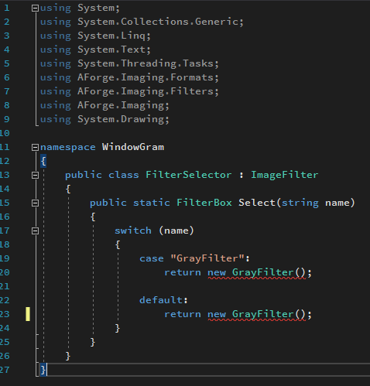
Code Demo
Class FilterSelector

Slide 8
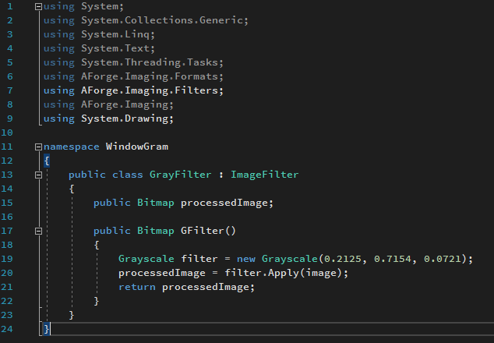
Code Demo
Class GrayFilter

Slide 9
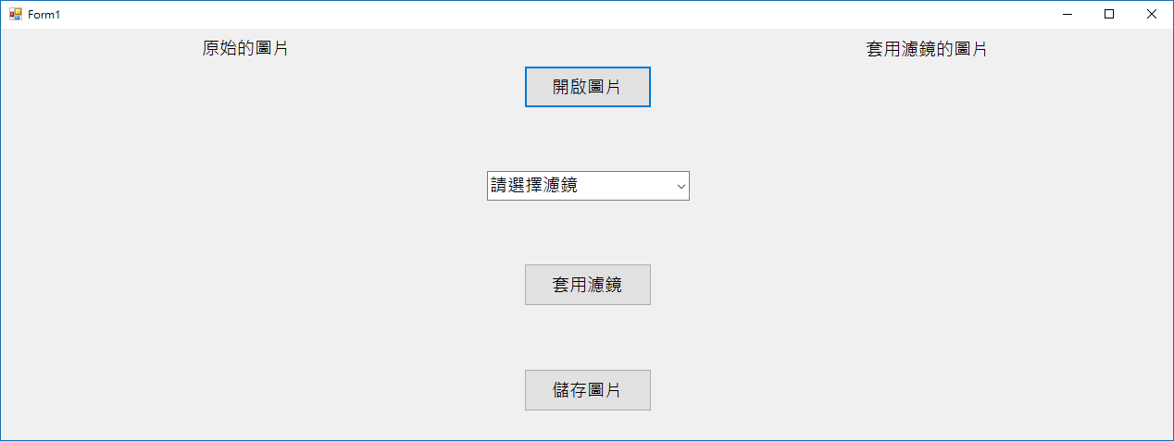
WindowGram

Slide 10

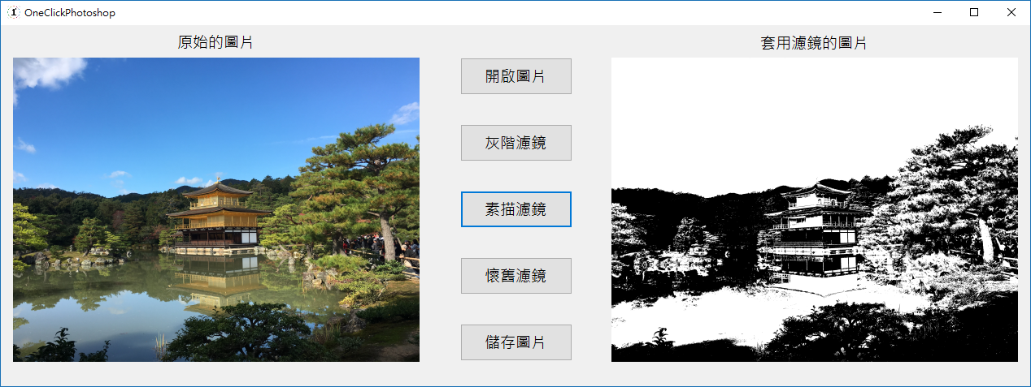
OneClickPhotoshop

Slide 11
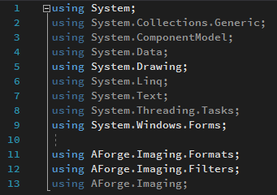
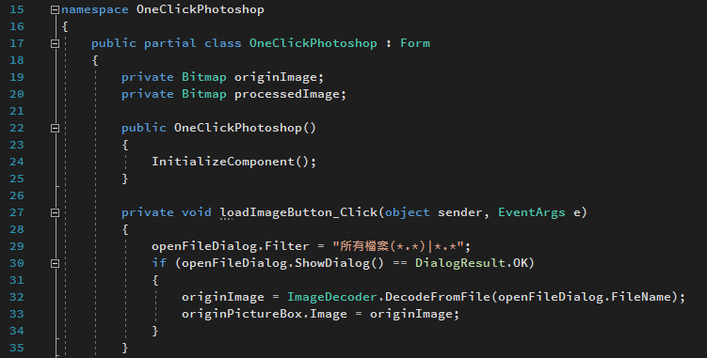
OneClickPhotoshop
Import Image

Slide 12
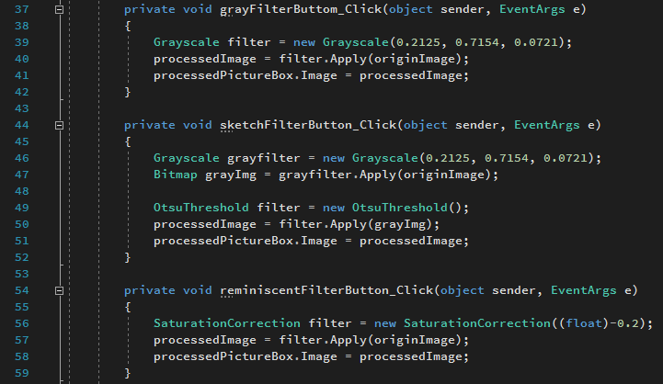
OneClickPhotoshop
Apply Filter

Slide 13
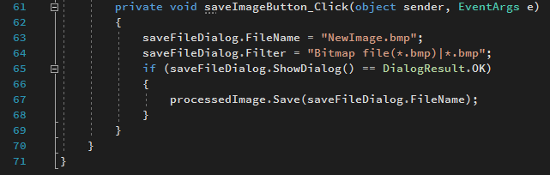
OneClickPhotoshop
Preview Result and Save Image

Slide 14
DEMO

Slide 15
The end. Thanks for your attention!!

